Slide 1

Lecture-1
Introduction To Algorithms
Ahmed Bin Mazhar
MSc (Advance Computer Science), BSc (Software Engineering)
IT Lecturer (University of Hertfordshire & North Herts College)
AI Researcher (Centre for Computer Science and Informatics Research)

Slide 2
Algorithm
A step-by-step procedure or formula for solving a problem or completing a task.
It is a finite set of well-defined instructions designed to perform a specific task.
Algorithms can be used in mathematics, computer science, and everyday life.

Slide 3
Key Characteristics of Algorithms:
Input
Output
Definiteness
Finiteness
Effectiveness

Slide 4
Key Characteristics of Algorithms:
Input: Zero or more quantities are externally supplied.
Output: At least one quantity is produced.
Definiteness: Each instruction is clear and unambiguous.
Finiteness: The algorithm terminates after a finite number of steps.
Effectiveness: Every step must be basic enough to be carried out by a human
(or a machine), in a finite amount of time.

Slide 5

Design an Algorithm
Activity 1:
Write an algorithm to make a cup of coffee. (Remember algorithm is a set of instructions)

Slide 6

Algorithm Steps
Understand the problem
Use clear and precise language
Define the inputs and outputs
Break down the problem
Use logical flow and organization
Provide clear instructions
Consider efficiency
Test and validate
Document
Improve

Slide 7

Let's Solve a Problem
Check if an input number is an even or an odd number
eg: Is 2 even or odd ??

Slide 8
Checking if a number is even or odd
2 % 2 = 0 then, it is even
3 % 2 = 1 then, it is odd
4 % 2 = 0 then, it is even
5 % 2 = 1 then, it is odd
6 % 2 = 0 then, it is even
7 % 2 = 1 then, it is odd
8 % 2 = 0 then, it is even
9 % 2 = 1 then, it is odd
Always finding even and odd we take modulus with respect to 2.

Slide 9
Write an Algorithm to find if a number is even or odd

Slide 10

Step 1: Understand the problem
Finding if a certain number is even or odd
Notes:
By this we mean if the problem statement is clear

Slide 11
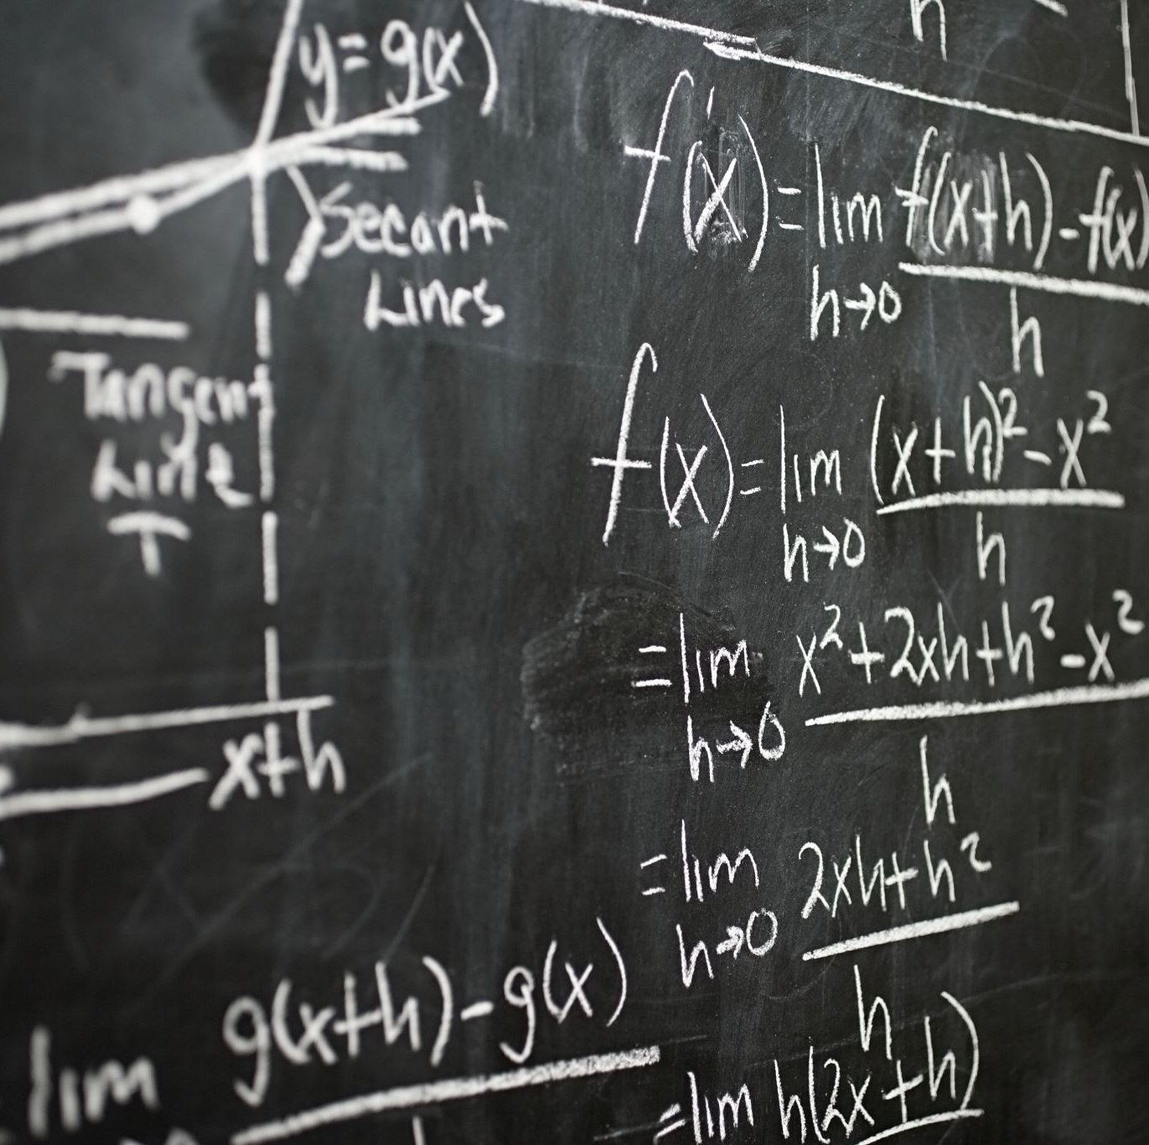
Step 2: Use clear and precise language
We will write this algorithm in English, as it’s a common language.

Slide 12

Step 3: Define the inputs and outputs
Input -> an unknown number X
Output -> even or odd

Slide 13

Step 4: Break down the problem
Part 1
Take an input
Part 2
Calculations
Part 3
Result

Slide 14

Step 5:Use logical flow and organization
Are we going step by step ??
Did we miss any step ??

Slide 15
Step 6:Provide clear instructions
By now you have known how to solve this problem can you clearly communicate the instructions ??
In general, by this what we mean is that do we have confidence in our solution.

Slide 16

Step 7:Consider Efficiency
Let's Check

Slide 17

Step 8: Test
Is it giving right output to a certain input
eg: is 2 an even or an odd number??
answer: yes

Slide 18

Step 9: Document
Make sure you explain each step while designing an algorithm
Same for coding
eg: printf(“hello world!”) // this line print a message hello world!

